Slide 1


IOT-BASED BUILDING SYSTEM
Experiment 6
Raphael S. Nano
CPE162P / C1
Computer Engineering Department
School of Electrical, Electronics, and Computer Engineering

Slide 2
Introduction: IoT-based Building System
Buildings utilize several components in accommodating the people that use rooms and the lights within those rooms
Managing in controlling the energy being used by the occupants or users
Several IoT-based systems are being developed
  light bulbs only turn on when people are present within a room
  the system is only activated if the people inside reach a certain minimum or limit

Slide 3
Objectives
To demonstrate how an IoT based Building system works.
To be able apply what were learned in logic circuits and switching theory, microprocessors, CPE160P, and CPE161P.
To be able to apply embedded systems with IoT using Arduino kit
To be able to use ThingSpeak for the data collection and analysis.

Slide 4
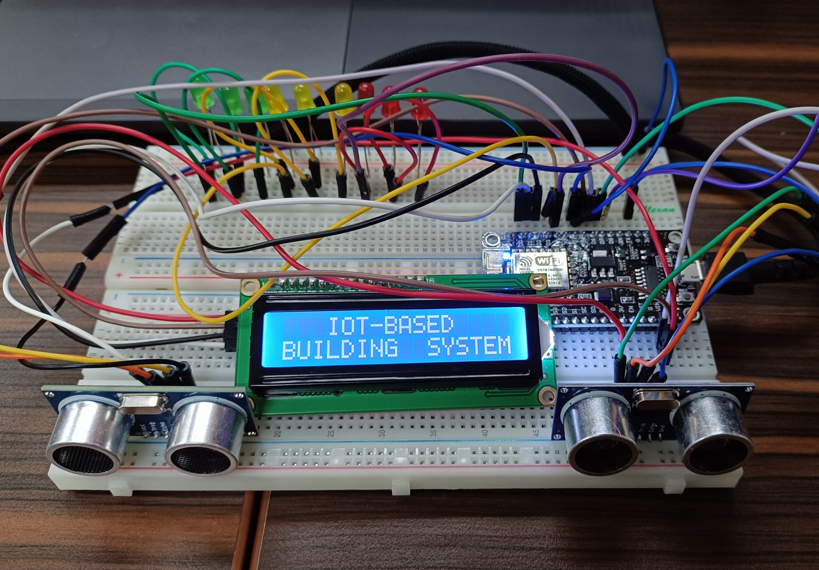
Materials
Hardware
ESP8266 WiFi Module
2 HC-SR04 Ultrasonic Distance Sensors
Liquid Crystal Display with I2C
LEDs

Slide 5
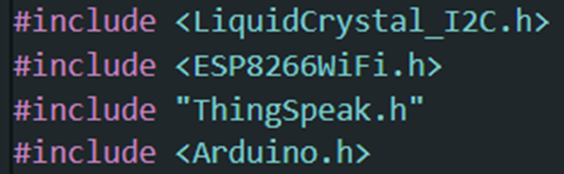
Materials
Software Libraries
ESP8266WiFi.h
ThingSpeak.h
LiquidCrystal_I2C.h

Slide 6
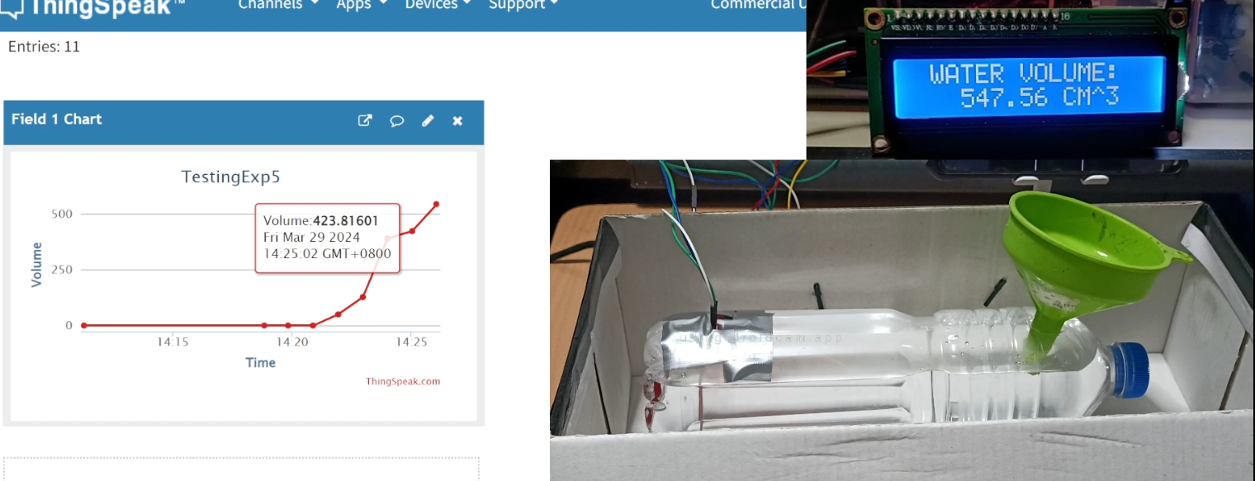
Discussion: IoT-based Water Monitoring System
Main Objectives:
  control the light usage in a specific meeting room
  lights will be lit up with increasing intensity based on the number of people that entered
ThingSpeak displays the number of occupants in a specific time and the status of light if it is ON or OFF

Slide 7
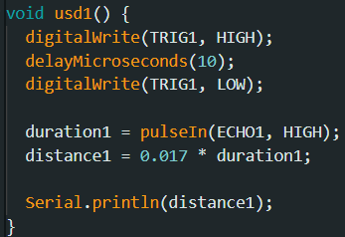
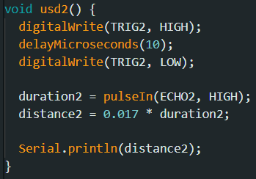
Discussion: IoT-based Building System
Primary Features
  Detection of Ultrasonic Distance Sensor
  Displaying of LCD
  Lighting up of LEDs
Ultrasonic Distance Sensors Function:
  1 for entry, 1 for exit
  pins assigned to each TRIG will be set to HIGH
  pulse will be received by the ECHO pins

Slide 8
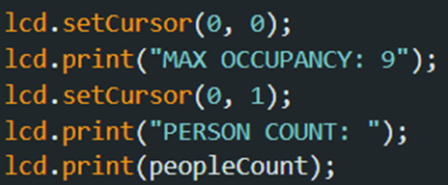
Discussion: IoT-based Building System
LCD Function:
  Display the number of occupants in the building or room using lcd.print()
  The max occupancy and current number of occupants are continuously displayed in the system

Slide 9
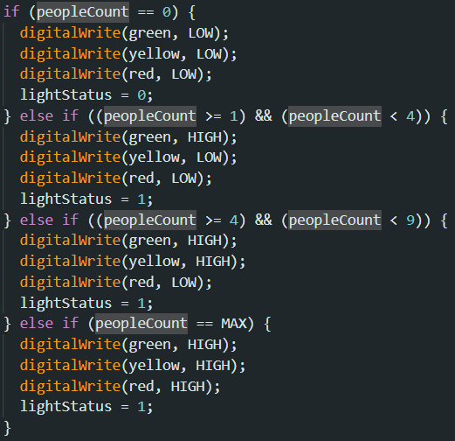
Discussion: IoT-based Building System
LEDs Function:
  No People: All are OFF
  1-4: 3 Green LEDs are ON
  5-8: 3 Yellow LEDs are ON
  9/Max: 3 Red LEDs are ON

Slide 10
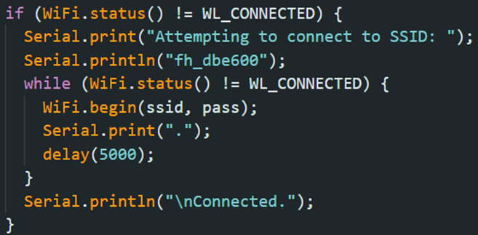
Discussion: IoT-based Building System
The same code was utilized in establishing the Wi-Fi connection. It provides information to the user via the Serial Monitor, indicating the status of the connection attempt

Slide 11
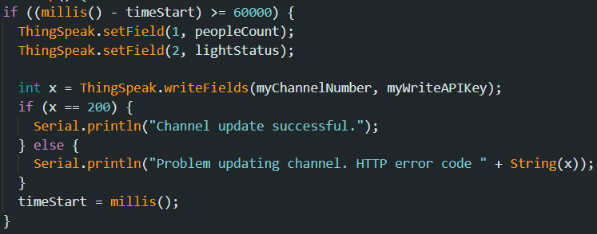
Discussion: IoT-based Building System
ThingSpeak updates its fields every 1 minute.
There are 2 fields:
  number of occupants
  status of light (if ON/1 or OFF/0)

Slide 12
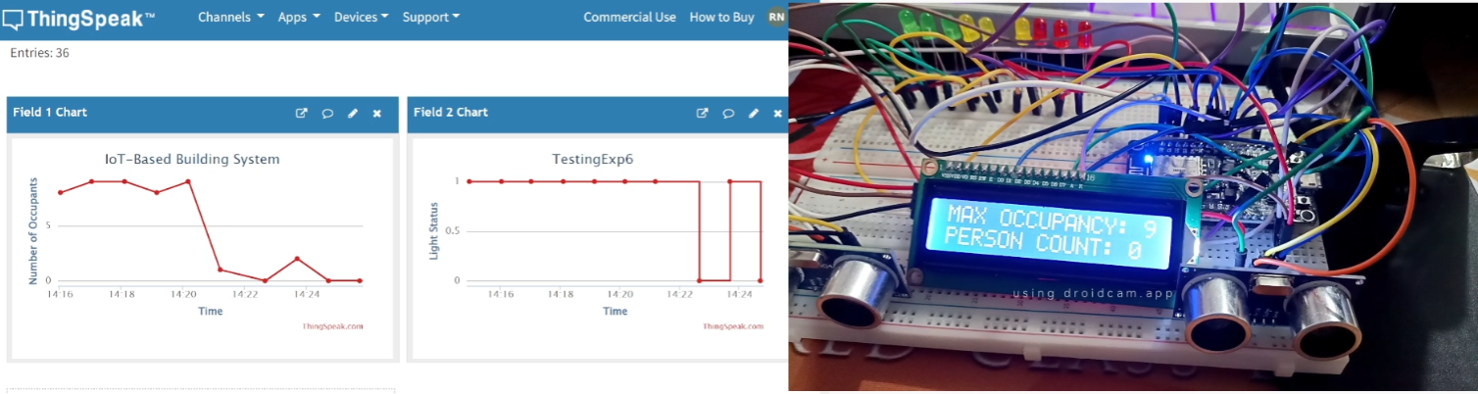
Results: IoT-based Building System
No People:
  no lights are turned ON
  LCD also specified that the person count is at 0
  ThingSpeak outputs the number of occupants = 0, and the status of the lights = OFF (0).
  If exit sensor detects something despite no one in the room, a prompt shows that nine spaces are available.

Slide 13
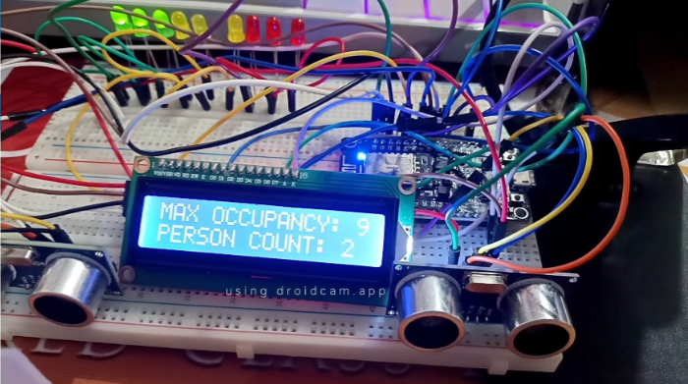
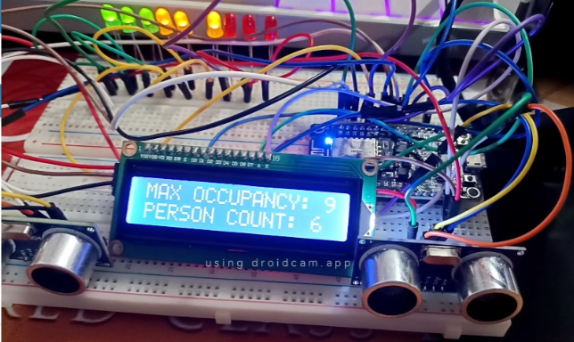
Results: IoT-based Building System
1-4 People:
  three green lights are turned ON
  ThingSpeak also displays the number of occupants accordingly
  status of the light is now 1 or ON
5-8 People:
  three yellow lights are turned ON
  person count in the LCD and the number of occupants in ThingSpeak is updated

Slide 14
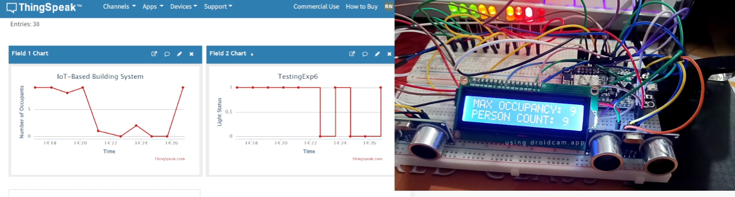
Results: IoT-based Building System
Max Occupants/9 People:
  the red LEDs are now ON and all of the LEDs are ON
  ThingSpeak also shows the number of people, which is 9
  LCD shows 9 in the person count
  If people try to enter, a maximum occupancy has been reached prompt is shown

Slide 15
Conclusion
The IoT-based Building System functions by:
  Usd1() and usd2() were created to activate the ultrasonic distance sensors
    Entry sensor will increment the number of occupants
    Exit sensor decrements it
  LCD simply prints the max occupancy and the current person count
  LEDs turns ON based on ranges 0, 1-4, 5-8, and 9

Slide 16
Conclusion
The second objective was achieved by:
  connecting the ESP8266 with ThingSpeak using Arduino IDE codes
  synchronizing the ultrasonic distance sensor inputs with the outputs in the LCD and LEDs
ThingSpeak implementation was accurate, since it regularly broadcasts the number of occupants and light status every minute.
Therefore, the IoT-based Building System was successfully developed, with accurate sensor readings and clear LCD and LED outputs.

